Slide 1

Basic C# Syntax
Course DNA
Summary:
Data types, arrays and lists, enums, basic object-orientation, methods, components, operators, decisions, loops.

Slide 2
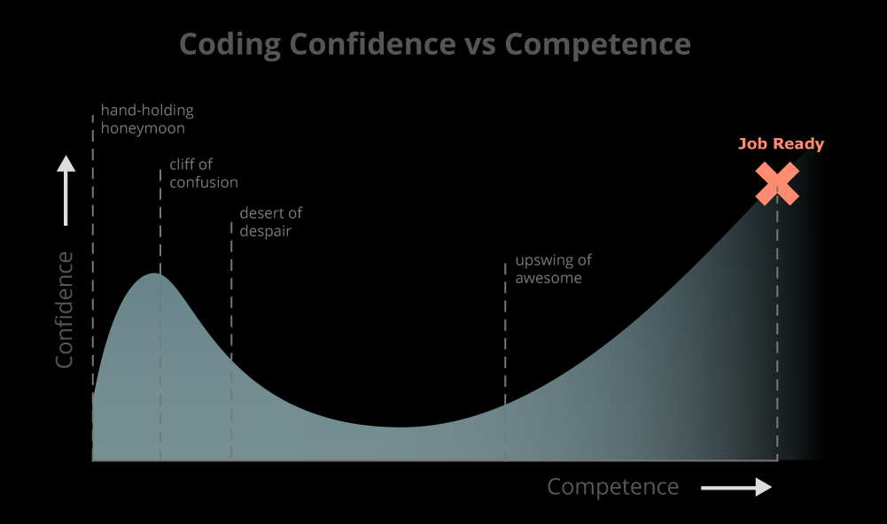
Overview
Variables and strings
Arrays
Enumerations
Component Objects
Methods
Operators
Comparisons
Switch
Conditional operator
Loops
Comments

Slide 3
Variables
As in most other programming languages, C# uses variables for storing data.
Unlike some scripting languages, you cannot just assign a piece of data to what’s called a variant type. E.g.
var myData = 15.7
var myOtherData = "A text string"
Instead, you have to specify the type of data that you intend to store.
This may seem tedious but it helps to improve the performance and compilation of code.
There are several so-called value types that C# understands natively. The main ones are:
bool, byte, char, double, float, int, long, short
For most things, knowledge of bool, float and int are sufficient (for now).

Slide 4
Boolean values
Booleans are simple true/false values.
Unlike in some languages, these values do not equate to 1 and 0.
Those are numbers.
Note, in C# that when you assign to a bool, the value (true or false) is written in lowercase.
C# is case-dependent so watch your use of upper and lower case.
Booleans are linked to binary in the sense that all binary circuits (and most are) work using logic gates (you may have heard use of terms like AND, OR and NOT).
The mathematics for these was created/formalised by an English mathematician in the 1850s
George Boole (1815 - 1864)
In computing, you use Boolean values when you want to store data that can only exist in one of two states. E.g.
bool shieldsDown = true;
bool canSpawn = false;

Slide 5
Whole number values
Whole numbers are also known as integers.
An integer can hold any number that does not require a fractional/decimal part.
This includes negative numbers and zero.
Unlike in real mathematics, when you store whole number data there is a fixed upper and lower value that can be represented.
For C#, integers can have values in the range −2,147,483,648 through +2,147,483,647.
So what happens if you add 1 to +2,147,483,647?
you get -2,147,483,648 (of course)
This is called overflow and you just have to bear it in mind if you start using really large values.
If you need a bigger range of numbers then consider either using uint (unsigned integers which double the normal range of an int by not allowing negative numbers) or long.
You can create an integer in C# like so:
int ammo = 5;
int liftLevel = -1;

Slide 6
Floating point number values
Floating point numbers are fractional values.
This means they have a decimal place.
Both the float and double type can store fractional values.
E.g.
float myNumber = 2.5386f;
double myOtherNumber = 3.141592653589793;
Note that the difference between a float and a double type is the amount of decimal places you can use accurately (approx. 7 places for a float and 15 for a double).
Mostly in games, you will use floats which have an f (or F) at the end of their value.
Internally, a double takes twice as much memory as a float.
The Unity API is built around using floats.
Also, don’t rely on the absolute accuracy of floating point numbers.
You cannot accurately represent the value 0.1 in floating point binary for instance.
look up Unums if you want to see where the future might lie in this regard.

Slide 7
String values
Strings are series of characters. Internally, they are still numbers because computers.
They are not a primitive value type (they are built from a class).
Because they are used a lot, a special syntax has been created for them in C#.
E.g.
string a = "hello";
string b = "h";
string both = a + b;
Note that you can use either String or string.
E.g.
string myFirstName = "Yvan";
String myLastName = "Cartwright";
My advice is to stick to using string instead of String because you would have to specify using the System.String class in your code otherwise… Seriously, don’t worry about this for now!

Slide 8
Arrays
If you find a need to store many similar variables which have the same type then you should consider using an array.
An array can be thought of as a simple list of data.
An item inventory in an RPG is a list, or the ships in an enemy attack wave for a shoot-em-up etc.
They are declared in a similar way to variables.
int [] myIntArray;
string [] myStringArray = new string[5];
The first example is an empty array that can store integer values.
The second is an array that holds five string values (or simply strings).

Slide 9
Array assignment
To assign a piece of data to a slot in an array we need two things:
the index (slot number) in which to store the data
the data to store
As with most other languages, array indexes start at 0 not 1 (because computers).
For our previous string array, we have indices between 0 and 4 inclusive.
To store a string in this array in index 3 (the fourth slot in the array) we do this:
myStringArray[3] = "This is the fourth slot!";

Slide 10
Simple Dynamic List
There are some restrictions with using simple arrays:
each array slot must store the same type of data
the length of the array is fixed
You cannot store mixed types (e.g. bools and ints in the same array).
It is actually possible to do this but you need to use object-orientation (more in a bit).
If you find you need more elements (slots) then you would have to create a new bigger array and copy the elements across from the old one.
This takes time for large arrays (even on a modern machine).
One solution is to use the collection framework built into C#
the collection framework is a library of code dedicated to common data structures
it is highly optimised and built for multi-threaded operation
This is a topic for the future but as a quick example, here’s a quick guide to using C#’s List class.

Slide 11
List
The List class is a dynamic storage system for holding lists of data.
This means the size of the List grows or shrinks as required.
To create a List, use the following syntax:
List<int> list = new List<int>();
list.Add(2);
list.Add(3);
list.Add(5);
There are many other methods in a List class.
Useful ones are Insert, Find, Remove, Sort, Reverse…
Sounds great so why bother learning about arrays?
Arrays require less memory and are faster in use.

Slide 12
Enumerations
It can be annoying to keep referring to a particular array slot by its index in larger scripts.
For instance, if a gameworld spawned a number of NPCs dependent on the day of the week the game clock was in, you could do the following:
int [] npcSpawner = new int[7];
npcSpawner[1] = 12; // on Monday, spawn twelve npcs
To keep remembering that Monday is index 1 throughout your script is tedious and error prone.
What if you change Monday to a different value (like 0) and you forget to change it everywhere in your code?
Later if you see npcSpawner[1] in your code, it could be an error or it may be correct.
Clearly this is bad and there must be a better technique?
This is where enumerations come in...

Slide 13
Enumerations
It would be easier if we could write script like the following:
npcSpawner[MONDAY] = 12;
Whilst it would be possible to create a global variable called MONDAY that has the value of 1, this is not good coding practice.
We would have 7 global variables, each holding an integer representing a day of the week.
What would stop a piece of script from altering this value?
What if we missed a value out?
The variables are each referring to a day of the week but the data is not held together which goes against the principle of encapsulation (part of Object Oriented coding).

Slide 14
Enumerations
Instead, in C# we can do this:
enum DaysOfTheWeek { SUNDAY, MONDAY, TUESDAY, WEDNESDAY, THURSDAY, FRIDAY, SATURDAY };
int [] npcSpawner = new int[7];
npcSpawner[DaysOfTheWeek.MONDAY] = 12;
Note: there is no comma here
There is a semi-colon here

Slide 15
Basic object orientation
In Ye Olde Days of Yore (pre-1970), most computer programs were basically a bunch of data and sets of instructions (called functions).
Whilst this kind of programming is fine, larger codes become quite complicated to organise and maintain.
The concepts of Object Oriented programming exist to provide a better mechanism for organising code.
Note that there is no single OO implementation used in computing.
It is a principle or a paradigm.
There are many other programming paradigms but OO is very popular for a variety of reasons.
It is up to the language designers to choose what parts of the paradigm are implemented and how in any given programming language.
Many programming languages can also use mixed-paradigms.
C# has: strong typing, imperative, declarative, functional, generic, object and component oriented.
No need to know or even worry about this!

Slide 16
Basic object orientation
Every object in a program is built from a class (treat it like a blueprint or template).
An object in a game could be an NPC, a moving door, the player character, the scoring system, a set of AI routines.
A class specifies what types of data objects built from it have.
Classes also hold methods (functions) which manipulate the data they store.
Objects interact inside the program by passing messages (data) to each other.
Objects also react to the environment they are in by responding to events (another form of message).
Each class then represents the data and functionality for a particular object.
From one class, many individual objects can be constructed.

Slide 17
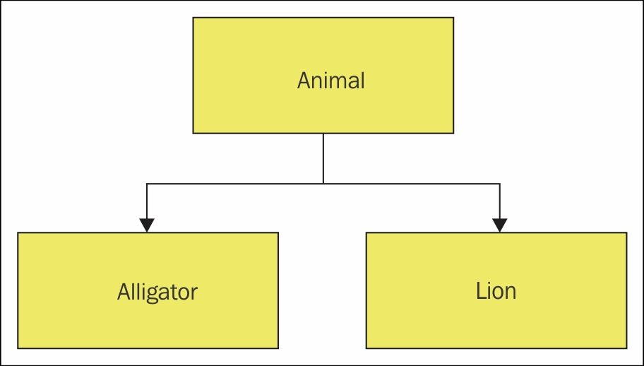
In pictorial form…
The class: type is Animal.
Sub-classes are Alligator, Lion etc.
The objects (or instances) of the class could be entities like Simba the Lion, Tony the Alligator etc.
Data could be: canSwim, speed, size, mammal, reptile, age etc.
Methods could be: move, jump, attack etc.

Slide 18
Methods (aka functions)
What is the difference?
mostly you can treat them as exactly the same thing.
strictly speaking, a function does simple input-processing-output .
a method does the same thing but the object to be processed is also passed to the method.
Methods/functions are the basic structural elements of most programming languages.
Generally, a method is a block of code that performs one useful task in a program.
Methods may require data to be sent to them for processing and they may return the result of processing back to the code that called them.
When you first create a script in Unity, an empty Start and Update method are automatically added to the code (which you may optionally delete).

Slide 19
Methods
The format for creating a method in C# is:
access_specifier return_type SomeMethodName( data_type param1, data_type param2, etc.)
{ // some code
}
E.g.
public void setStudentAsleep ( Student aStudent ) { aStudent.asleep = true; }
In C#, the access specifier and parameters are optional.
To call a method from another piece of code, you need to use the name of the method, open up a pair of normal brackets and list the data that you need to send to the method separated by commas.
E.g. SomeName(myData, myStringArray);

Slide 20
Returning values
Like most other programming languages, C# can return only one piece of data from a method.
Do not despair!
That data can be something as simple as a numeric value or as complicated as a whole set of GameObjects with all of their associated data.
To return a piece of data from a method, you use the return type in the header and the return keyword in your code.
E.g.
public int addNPC(string name) { npcList.Add(name); return npcList.Count; }
This class header defines a publically-accessible method that is:
called addNPC
is sent a string as an input
returns an integer
The code inside the method:
adds the string data to a List called npcList
returns the new size of the list
Unity v2018.3 supports C# v7 which does allow multiple values to be returned from a method 8)

Slide 21
Component objects
In Unity, components are attached to GameObjects.
You’ve seen some of these already.
The position of a GameObject in a scene is held by a Transform component.
There are many such components and you can look them up in the Unity documentation.
To store data of a given component so that you can manipulate it in script, you can store it in a variable/object.
Transform gamePos = gameObject.transform;
Note: you could assign any GameObject to this variable so long as it has a transform component as part of it (which they all do).

Slide 22
Operators
All programming languages work on the concept of manipulating data (numbers to machines).
To perform mathematical manipulations of data, a series of operators are used.
As in most other languages these are as follows:
* is multiplication
/ is division
+ is addition
- is subtraction
% is modulus
The + operator is also used to concatenate strings (or strings and numbers) together.
You can also use the ++ and -- notation used in C++, Java, etc.
E.g.
myInt++;

Slide 23
Comparisons
When performing tests on numbers, it is useful to be able to check whether one number is equivalent to another number, or is greater than it etc.
To do this in C#, you can use these comparison operators:
< is less than
> is greater than
== is equivalent to
<= is less than or equivalent to
>= is greater than or equivalent to
!= is not equivalent to

Slide 24
Boolean operators
There are times when you may need to perform several checks of data at the same time.
For this you use the Boolean operators.
Like Java and C++, you have to use the C-derived versions of these operators.
&& is AND
|| is OR (note: some keyboards actually don't include this symbol called a 'pipe')
! is NOT

Slide 25
IF Statements
You use IF statements before for performing decision-making within code.
In C#, the syntax is much the same as for Java and C++.
if (myData == 4) { // do something
}
A lot of game logic is built with tests that utilise IF statements

Slide 26
IF-ELSE Statements
You can also do IF-ELSE statements easily:
if (myData == 4) { // do something } else { // do something different }
You can read this as:
IF the value stored in the variable myData is the same as 4, execute the code in // do something
ELSE
execute the code in // do something different

Slide 27
IF-ELSE IF-ELSE statements
To give you full flexibility, you can even do IF-ELSEIF-ELSE statements.
if (myData < 4) { // do something if the number is less than 4 } else if (myData > 4) { // do something if the number is greater than 4 } else { // do something if none of the above is true }

Slide 28
Switch statements
Switch statements are similar to if-else if-else statements.
They are used to perform a piece of code depending on a matching case being met and take the following form.
switch (myInt) // note: could match strings too { case 0: // do something break; case 1: // do something break; default: // do something if none of the above match
break; }

Slide 29
Loops - FOR
There are two loop types in C#, the determinate loop and the indeterminate loop.
The determinate loop is the for loop and has the following format:
for (startValue; test condition; stepCounter) { // stuff to do whilst looping }
E.g.
for (int i = 0; i < 10; i++) { Debug.Log("i = " + i); }

Slide 30
Loops - WHILE
The indeterminate loop is the while loop and has this format:
while (some condition is true) { // stuff to do whilst looping }
E.g.
while (gameRunning == true)
{
input();
update();
draw();
}
Note: there is no semi-colon here

Slide 31
Loops – DO-WHILE
There is a do-while loop in C#.
This is the same as a while loop but is guaranteed to run the contents of the loop at least once.
do
{
input();
update();
draw();
}
while (gameRunning == true);
Note: there is a semi-colon here

Slide 32
Comments
There are three forms of comments in C#.
The single line comments are specified using the double forward slash //
Multiple line comments are specified as follows:
/* here is a comment and another one */
You can also add comments that can be read by web reporters (like DoxyGen).
These comments may also include XML tags.
These use triple backslashes in C# (more on this next year if you take Social & Mobile).

